Slide 1
Capstone Project - Battle of Neighborhoods
Analyzing the competition in New York to open a new Night Club

Slide 2
Introduction
The City of New York, is well know as one of the cities with the most agitated night life in the world. The Entertaining Market is one of the most profitables, but also highly competitive, with several options for people to choose from. Market is highly competitive.

Slide 3
Business Problem
The client wants to open his Night Club business in New York, so he asks for a visual feedback of his potential competitors. I decided to extract the data of the city registered at Foursquare and show it on an interactive map, with markers identified by their names.

Slide 4
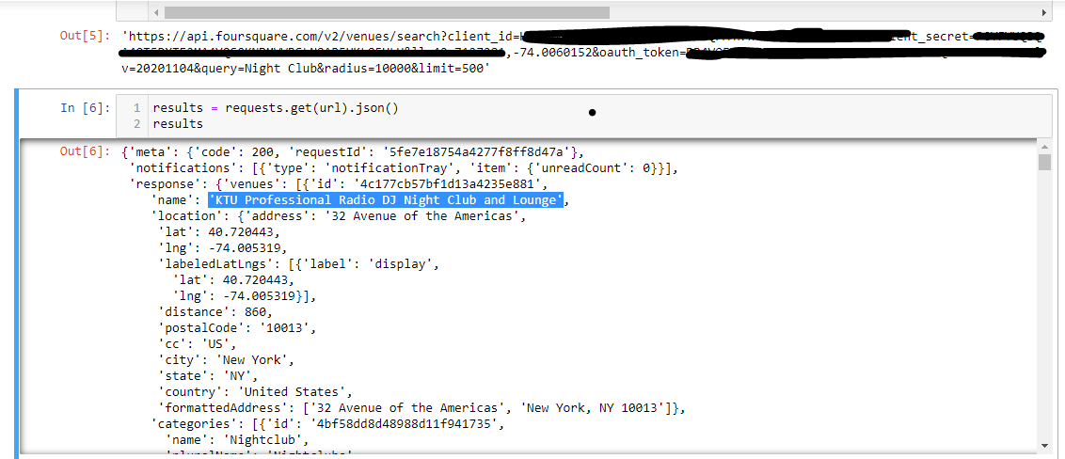
Data Scraping
Data scraping was done using Foursquare API to collect the information about Night Clubs in a 10 km radius area, from the coordinates of New York.

Slide 5
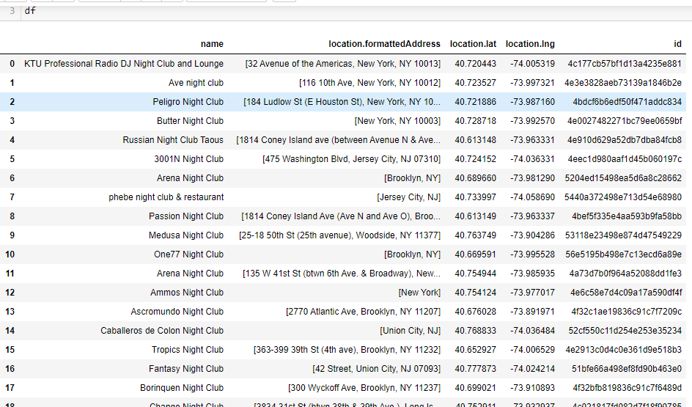
Data Selecting
From the acquired JSON, now in a dataframe, I filtered the relevant data: 'name','location.formattedAddress', 'location.lat','location.lng', 'id', and converted to dataframe to explore and organize

Slide 6
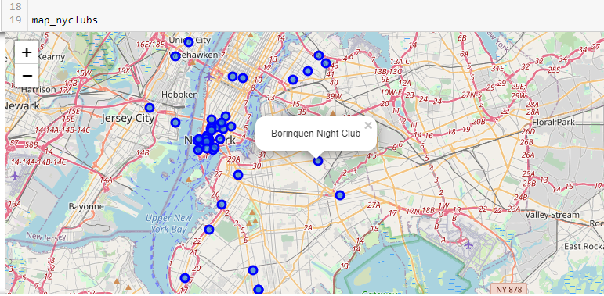
Data Presentation
With that information, I created the interactive map using Folium.

Slide 7
Methodology
I used Foursquare API to explore New York Night Clubs in a 10 km radius, where I found 50 Clubs is that area, from the New York coordinated provided by Geocode.
I transformed the JSON file into a dataframe, I filtered the relevant features: 'name','location.formattedAddress', 'location.lat','location.lng', 'id'.
With the data filtered and organized, the Folium library was used to give the visual feedback requested by the client, with markers to each Night Club and labels to identify.

Slide 8
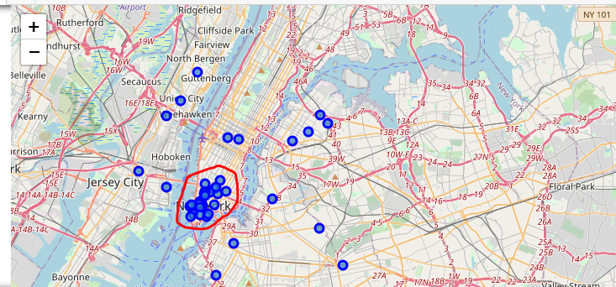
Results
The area south of Manhattam island would be a difficult area, because there is a dense concentration of Night Clubs there. From the competition perspective, it is not advised to open a new business of that kind there.
At the center and north of Manhattam, sparse Night Clubs or no clubs at all, so it could be a good option at first to open a business of that kind there. Outside Manhattan, the same pattern repeats, with sparse, not many Night Clubs, so they can be another area of interest.

Slide 9
Discussion
Foursquare API seems to be limited and outdated, so this definitely influences the research.
• There is high competition in the South of Manhattan, so it would be risky to open a new Night Club business due to intense competition.
• At the Center, North and outside Manhattan, there are few Night Clubs, which could be an interesting area to study the viability. As for competition in those areas, that would not be a problem

Slide 10
Conclusion
There is definitely room for improvement in this project.
Finding a new source of information would be advised as well, as Foursquare seems limited and outdated, even when I changed the version to 2020.

